Slide 1


International Economics: Theory and Policy
Twelfth Edition
Chapter 17
Output and the Exchange Rate in the Short Run
Copyright © 2022, 2018, 2015 Pearson Education, Inc. All Rights Reserved
Notes:
If this PowerPoint presentation contains mathematical equations, you may need to check that your computer has the following installed:
1) MathType Plugin
2) Math Player (free versions available)
3) NVDA Reader (free versions available)

Slide 2
Learning Objectives (1 of 2)
17.1 Explain the role of the real exchange rate in determining the aggregate demand for a country’s output.
17.2 See how an open economy’s short-run equilibrium can be analyzed as the intersection of an asset market equilibrium schedule (A A) and an output market equilibrium schedule (D D).
17.3 Understand how monetary and fiscal policies affect the exchange rate and national output in the short run.

Slide 3
Learning Objectives (2 of 2)
17.4 Describe and interpret the long-run effects of permanent macroeconomic policy changes.
17.5 Explain the relationship among macroeconomic policies, the current account balance, and the exchange rate.

Slide 4
Preview
Determinants of aggregate demand in the short run
A short-run model of output markets
A short-run model of asset markets
A short-run model for both output markets and asset markets
Effects of temporary and permanent changes in monetary and fiscal policies
Adjustment of the current account over time
I S-L M model

Slide 5
Introduction
Long-run models are useful when all prices of inputs and outputs have time to adjust.
In the short run, some prices of inputs and outputs may not have time to adjust, due to labor contracts, costs of adjustment, or imperfect information about willingness of customers to pay at different prices.
This chapter builds on the short-run and long-run models of exchange rates to explain how output is related to exchange rates in the short run.
It shows how macroeconomic policies can affect production, employment, and the current account.

Slide 6
Determinants of Aggregate Demand (1 of 3)
Aggregate demand is the aggregate amount of goods and services that individuals and institutions are willing to buy:
consumption expenditure
investment expenditure
government purchases
net expenditure by foreigners: the current account

Slide 7
Determinants of Aggregate Demand (2 of 3)
Determinants of consumption expenditure include:
Disposable income: income from production (Y) minus taxes (T).
More disposable income means more consumption expenditure, but consumption typically increases less than the amount that disposable income increases.
Real interest rates may influence the amount of saving and spending on consumption goods, but we assume that they are relatively unimportant here.
Wealth may also influence consumption expenditure, but we assume that it is relatively unimportant here.

Slide 8
Determinants of Aggregate Demand (3 of 3)
Determinants of the current account include:
Real exchange rate: prices of foreign products relative to the prices of domestic products, both measured in
domestic currency:
As the prices of foreign products rise relative to those of domestic products, expenditure on domestic products rises, and expenditure on foreign products falls.
Disposable income: more disposable income means more expenditure on foreign products (imports).

Slide 9
Table 17.1 Factors Determining the Current Account
Change | Effect on Current Account, C A
Real exchange rate, start fraction E P asterisk over P end fraction upward arrow | C A upward arrow
Real exchange rate, start fraction E P asterisk over P end fraction downward arrow | C A downward arrow
Disposable income, Y super d upward arrow | C A downward arrow
Disposable income, Y super d downward arrow | C A upward arrow

Slide 10
How Real Exchange Rate Changes Affect the Current Account (1 of 2)
The current account measures the value of exports relative to the value
of imports:
When the real exchange rate
rises, the prices
of foreign products rise relative to the prices of domestic products.
The volume of exports that are bought by foreigners rises.
The volume of imports that are bought by domestic residents falls.
The value of imports in terms of domestic products rises: the value/price of imports rises, since foreign products are more valuable/expensive.

Slide 11
How Real Exchange Rate Changes Affect the Current Account (2 of 2)
If the volumes of imports and exports do not change much, the value effect may dominate the volume effect when the real exchange rate changes.
For example, contract obligations to buy fixed amounts of products may cause the volume effect to be small.
However, evidence indicates that for most countries the volume effect dominates the value effect after 1 year or less.
Let’s assume for now that a real depreciation leads to an increase in the current account: the volume effect dominates the value effect.

Slide 12
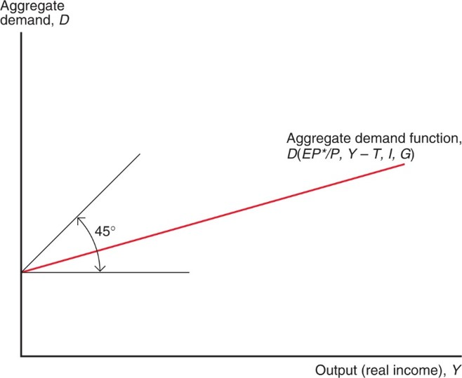
Figure 17.1 Aggregate Demand as a Function of Output
Aggregate demand is a function of the real exchange rate
disposable
income
investment demand (I), and government spending (G). If all
other factors remain unchanged, a rise in output (real income), Y, increases aggregate demand. Because the increase in aggregate demand is less than the increase in output, the slope of the aggregate demand function is less than 1 (as indicated by its position within the 45-degree angle).
Notes:
The plot of the aggregate demand function, D of E P star over P, Y minus T, I, and G, rises diagonally from the positive D-axis at an angle less than 45 degrees from the horizontal.

Slide 13
Determinants of Aggregate Demand (1 of 4)
Determinants of the current account include:
Real exchange rate: an increase in the real exchange rate increases the current account.
Disposable income: an increase in the disposable income decreases the current account.

Slide 14
Determinants of Aggregate Demand (2 of 4)
For simplicity, we assume that exogenous political factors determine government purchases G and the level of taxes T.
For simplicity, we currently assume that investment expenditure I is determined by exogenous business decisions.
A more complicated model shows that investment depends on the cost of spending or borrowing to finance investment: the interest rate.

Slide 15
Determinants of Aggregate Demand (3 of 4)
Aggregate demand is therefore expressed as:
where
is consumption expenditure as a
function of disposable income,
I + G is investment expenditure and government purchases (both exogenous), and
is the current account as a function of the real
exchange rate and disposable income.
Or more simply:

Slide 16
Determinants of Aggregate Demand (4 of 4)
Determinants of aggregate demand include:
Real exchange rate: an increase in the real exchange rate increases the current account, and therefore increases aggregate demand of domestic products.
Disposable income: an increase in the disposable income increases consumption expenditure, but decreases the current account.
Since consumption expenditure is usually greater than expenditure on foreign products, the first effect dominates the second effect.
As income increases for a given level of taxes, aggregate consumption expenditure and aggregate demand increase by less than income.

Slide 17
Short-Run Equilibrium for Aggregate Demand and Output
Equilibrium is achieved when the value of output and income from production Y equals the value of aggregate demand D
where aggregate demand is a function of the real exchange rate, disposable income, investment expenditure, and government purchases.

Slide 18
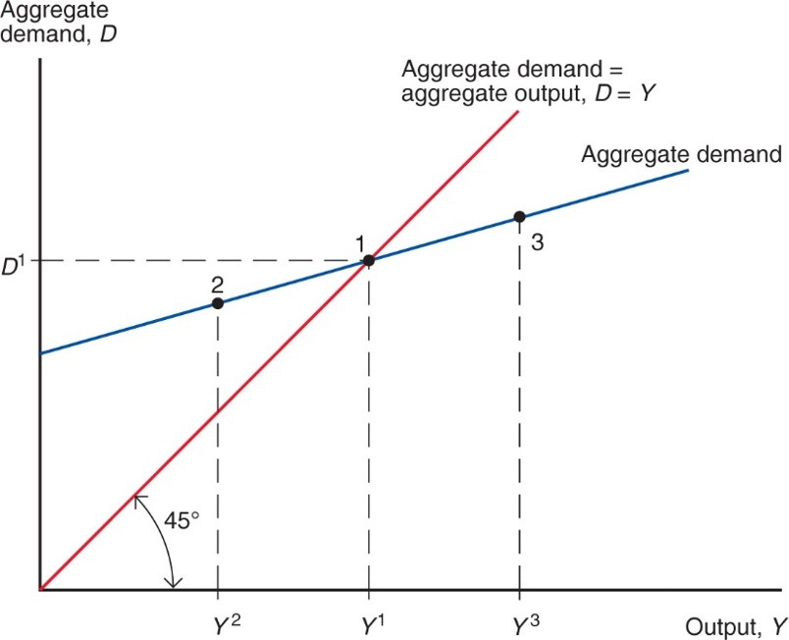
Figure 17.2 The Determination of Output in the Short Run
In the short run, output settles at
(point 1), where aggregate
demand,
equals aggregate output,
Notes:
The top coordinate system has a vertical axis for exchange rate E in the foreign market, and the bottom coordinate system has a vertical axis for real domestic money holdings in the money market. In the bottom plane, the graph of the real money supply is horizontal at M super S over P. The money demand curve L of R and Y super 1 rises with decreasing steepness through the real money supply curve at point 1 where x = R super 1. In the top plane, the graph of domestic-currency return on foreign-currency deposits falls with decreasing steepness through point 1 prime at (R super 1, E super 1). As the output rises, the money demand curve shifts downward, forming the graph of L of R and Y super 2. This graph rises through point 2 at (R super 2, M super S over P). At x = R super 2, the domestic-currency return plot falls through point 2 prime, where y = E super 2.

Slide 19
Short-Run Equilibrium and the Exchange Rate: D D Schedule (1 of 2)
How does the exchange rate affect the short-run equilibrium of aggregate demand and output?
With fixed domestic and foreign levels of average prices, a rise in the nominal exchange rate makes foreign goods and services more expensive relative to domestic goods and services.
A rise in the nominal exchange rate (a domestic currency depreciation) increases aggregate demand of domestic products.
In equilibrium, production will increase to match the higher aggregate demand.

Slide 20
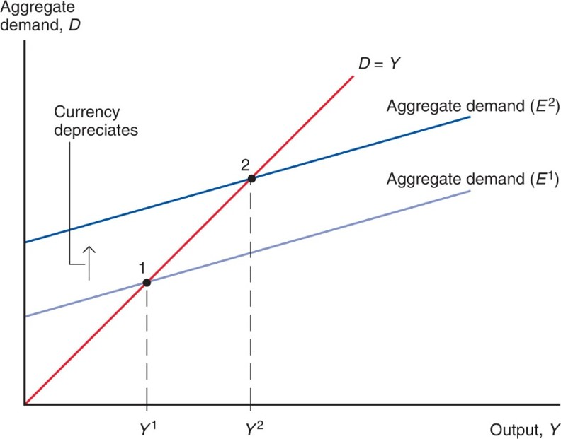
Figure 17.3 Output Effect of a Currency Depreciation with Fixed Output Prices
A rise in the exchange rate from
(a currency depreciation)
raises aggregate demand to Aggregate demand
and output to
all else equal.
Notes:
The demand curve D = Y rises from the origin, and the initial aggregate demand curve E super 1 rises from the y-axis with a lesser slope, so that it intersects the plot for D = Y at point 1 where x = Y super 1. As currency depreciates, the aggregate demand curve shifts upward, forming the graph of aggregate demand for E super 2. The new curve intersects the plot of D + Y at point 2, where x = Y super 2.

Slide 21
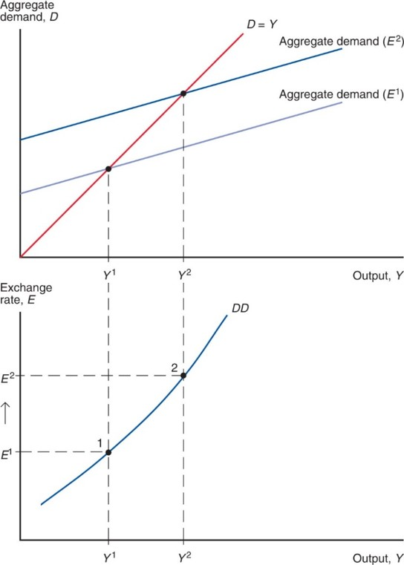
Figure 17.4 Deriving the D D Schedule
The D D schedule (shown in the lower panel) slopes upward because a rise in the
exchange rate from
all else equal, causes output to rise from
Notes:
The aggregate demand curve for E super 1 intersects the plot of D = Y at point 1, where x = Y super 1. The corresponding D D curve rises through point 1 at (Y super 1, E super 1). The initial aggregate demand curve then shifts upward to form the aggregate demand curve for E super 2. This curve intersects the plot of D = Y at point 2, which is up and right of point 1, where x = Y super 2. The corresponding D D curve rises through point 2 at (Y super 2, E super 2).

Slide 22
Short-Run Equilibrium and the Exchange Rate: D D Schedule (2 of 2)
D D schedule
shows combinations of output and the exchange rate at which the output market is in short-run equilibrium (such that aggregate demand = aggregate output).
slopes upward because a rise in the exchange rate causes aggregate demand and aggregate output to rise.

Slide 23
Shifting the D D Curve (1 of 3)
Changes in the exchange rate cause movements along a D D curve. Other changes cause it to shift:
Changes in G: more government purchases cause higher aggregate demand and output in equilibrium. Output increases for every exchange rate: the D D curve shifts right.
Changes in T: lower taxes generally increase consumption expenditure, increasing aggregate demand and output in equilibrium for every exchange rate: the D D curve shifts right.

Slide 24
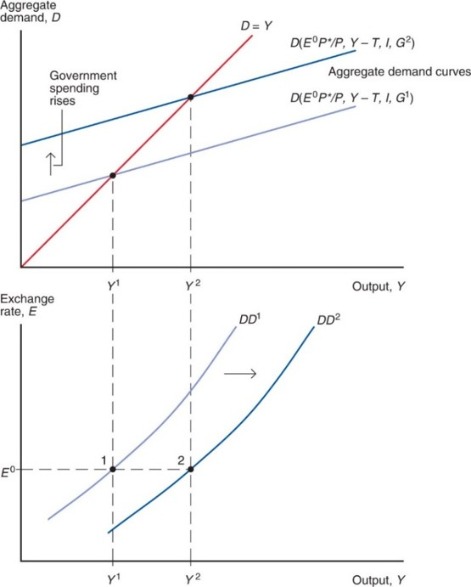
Figure 17.5 Government Demand and the Position of the D D Schedule
A rise in government demand from
raises output at every level of
the exchange rate. The change therefore shifts D D to the right.
Notes:
The initial aggregate demand curve D of E super 0 P star over P, Y minus T, I, and G super 1, rises through the plot for D = Y at x = Y super 1. The corresponding exchange rate curve D D super 1 rises through point 1 at (Y super 1, E super 0). As government spending rises, the initial aggregate demand curve shifts upward, forming the graph of D of E super 0 P star over P, Y minus T, I, and G super 2. This curve rises through the plot of D = Y at a point up and right of the first intersection, where x = Y super 2. Similarly, the D D super 1 curve shifts rightward to form the D D super 2 curve, which rises through point 2 at (Y super 2, E super 0).

Slide 25
Shifting the D D Curve (2 of 3)
Changes in I: higher investment expenditure shifts the D D curve right.
Changes in P: higher domestic prices make domestic output more expensive compared to foreign output and reduce net export demand, shifting the D D curve left.
Changes in P*: higher foreign prices make domestic output less expensive compared to foreign output and increase net export demand, shifting the D D curve right.

Slide 26
Shifting the D D Curve (3 of 3)
Changes in C: willingness to consume more and save less shifts the D D curve right.
Changes in demand of domestic goods relative to foreign goods: willingness to consume more domestic goods relative to foreign goods shifts the D D curve right.

Slide 27
Short-Run Equilibrium in Asset Markets (1 of 2)
Consider two sets of asset markets:
Foreign exchange markets
interest parity represents equilibrium:
Money market
Equilibrium occurs when the quantity of real monetary assets supplied matches the quantity of real monetary
assets demanded:
A rise in income from production causes the demand of real monetary assets to increase.

Slide 28
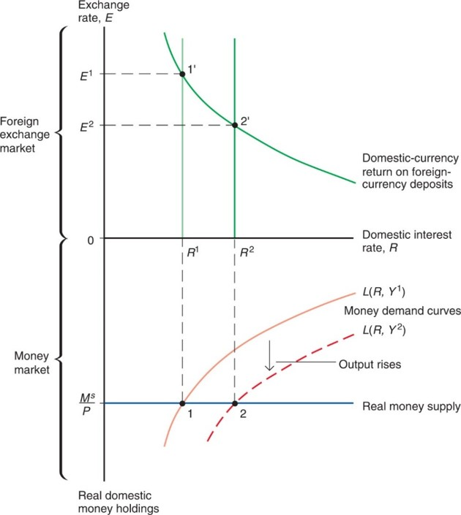
Figure 17.6 Output and the Exchange Rate in Asset Market Equilibrium
For the asset (foreign exchange and money) markets to remain in equilibrium, a rise in output must be accompanied by an appreciation of the currency, all else equal.
Notes:
The top coordinate system has a vertical axis for exchange rate E in the foreign market, and the bottom coordinate system has a vertical axis for real domestic money holdings in the money market. In the bottom plane, the graph of the real money supply is horizontal at M super S over P. The money demand curve L of R and Y super 1 rises with decreasing steepness through the real money supply curve at point 1 where x = R super 1. In the top plane, the graph of domestic-currency return on foreign-currency deposits falls with decreasing steepness through point 1 prime at (R super 1, E super 1). As the output rises, the money demand curve shifts downward, forming the graph of L of R and Y super 2. This graph rises through point 2 at (R super 2, M super S over P). At x = R super 2, the domestic-currency return plot falls through point 2 prime, where y = E super 2.

Slide 29
Short-Run Equilibrium in Asset Markets (2 of 2)
When income and production increase,
demand of real monetary assets increases,
leading to an increase in domestic interest rates,
leading to an appreciation of the domestic currency.
Recall that an appreciation of the domestic currency is represented by a fall in E.
When income and production decrease, the domestic currency depreciates and E rises.

Slide 30
Short-Run Equilibrium in Asset Markets: A A Curve
The inverse relationship between output and exchange rates needed to keep the foreign exchange markets and the money market in equilibrium is summarized as the A A curve.

Slide 31
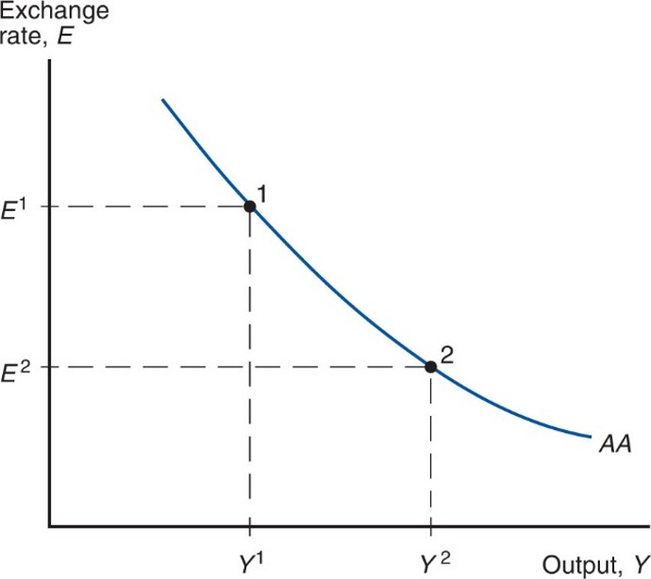
Figure 17.7 The A A Schedule
The asset market equilibrium schedule (A A) slopes downward because a
rise in output from
all else equal, causes a rise in the home
interest rate and a domestic currency appreciation from
Notes:
The plot for Ay Ay falls with decreasing steepness through point 1, at (Y super 1, E super 1) and then point 2, at (Y super 2, E super 2).

Slide 32
Shifting the A A Curve (1 of 3)
Changes in
an increase in the money supply
reduces interest rates in the short run, causing the domestic currency to depreciate (a rise in E) for every Y: the A A curve shifts up (right).
Changes in P: An increase in the level of average domestic prices decreases the supply of real monetary assets, increasing interest rates, causing the domestic currency to appreciate (a fall in E): the A A curve shifts down (left).

Slide 33
Shifting the A A Curve (2 of 3)
Changes in
if market participants expect the
domestic currency to depreciate in the future, foreign currency deposits become more attractive, causing the domestic currency to depreciate (a rise in E): the A A curve shifts up (right).
Changes in R * : An increase in the foreign interest rates makes foreign currency deposits more attractive, leading to a depreciation of the domestic currency (a rise in E): the A A curve shifts up (right).

Slide 34
Shifting the A A Curve (3 of 3)
Changes in the demand of real monetary assets: if domestic residents are willing to hold a lower amount of real money assets and more non-monetary assets, interest rates on nonmonetary assets would fall, leading to a depreciation of the domestic currency (a rise in E): the A A curve shifts up (right).

Slide 35
Putting the Pieces Together: the D D and A A Curves (1 of 2)
A short-run equilibrium means a nominal exchange rate and level of output such that
equilibrium in the output markets holds: aggregate demand equals aggregate output.
equilibrium in the foreign exchange markets holds: interest parity holds.
equilibrium in the money market holds: the quantity of real monetary assets supplied equals the quantity of real monetary assets demanded.

Slide 36
Putting the Pieces Together: the D D and A A Curves (2 of 2)
A short-run equilibrium occurs at the intersection of the D D and A A curves:
output markets are in equilibrium on the D D curve
asset markets are in equilibrium on the A A curve

Slide 37
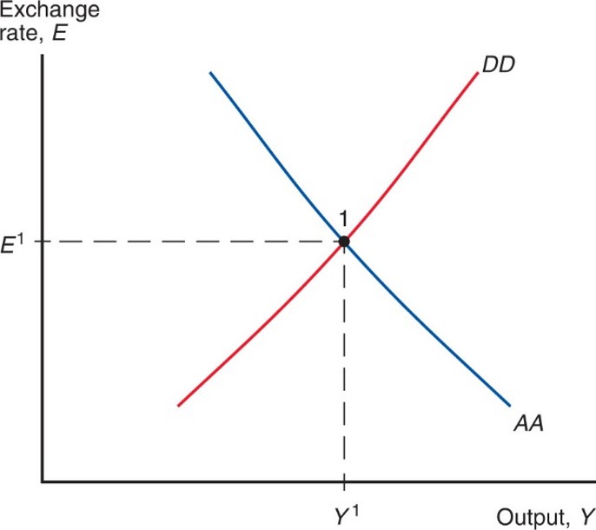
Figure 17.8 Short-Run Equilibrium: The Intersection of D D and A A
The short-run equilibrium of the economy occurs at point 1, where the output market (whose equilibrium points are summarized by the D D curve) and the asset market (whose equilibrium points are summarized by the A A curve) simultaneously clear.

Slide 38
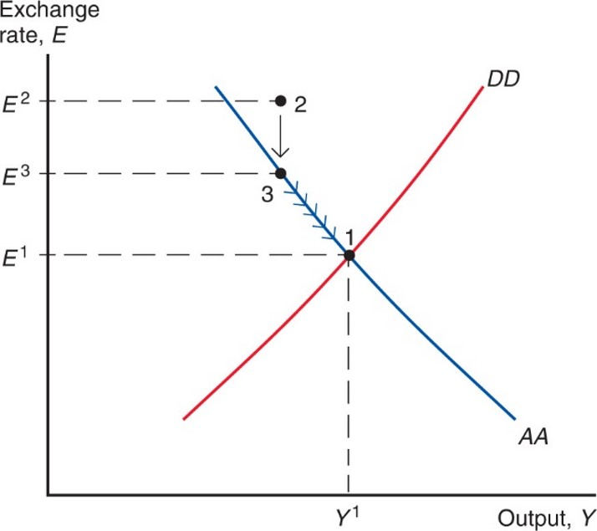
Figure 17.9 How the Economy Reaches Its Short-Run Equilibrium
Because asset markets adjust very quickly, the exchange rate jumps immediately from point 2 to point 3 on A A. The economy then moves to point 1 along A A as output rises to meet aggregate demand.
Notes:
The falling Ay Ay curve intersects the rising D D curve at point 1, which has coordinates (Y super 1, E super 1). Point 2 is above the Ay Ay curve, up and left of point 1 at y = E super 2. Point 3 is directly below point 2, on the Ay Ay curve at E super 3. Movement occurs along the Ay Ay curve from point 3 to point 1.

Slide 39
Temporary Changes in Monetary and Fiscal Policy
Monetary policy: policy in which the central bank influences the supply of monetary assets.
Monetary policy is assumed to affect asset markets first.
Fiscal policy: policy in which governments (fiscal authorities) influence the amount of government purchases and taxes.
Fiscal policy is assumed to affect aggregate demand and output first.
Temporary policy changes are expected to be reversed in the near future and thus do not affect expectations about exchange rates in the long run.

Slide 40
Temporary Changes in Monetary Policy
An increase in the quantity of monetary assets supplied lowers interest rates in the short run, causing the domestic currency to depreciate (E rises).
The A A shifts up (right).
Domestic products relative to foreign products are cheaper, so that aggregate demand and output increase until a new short-run equilibrium is achieved.

Slide 41
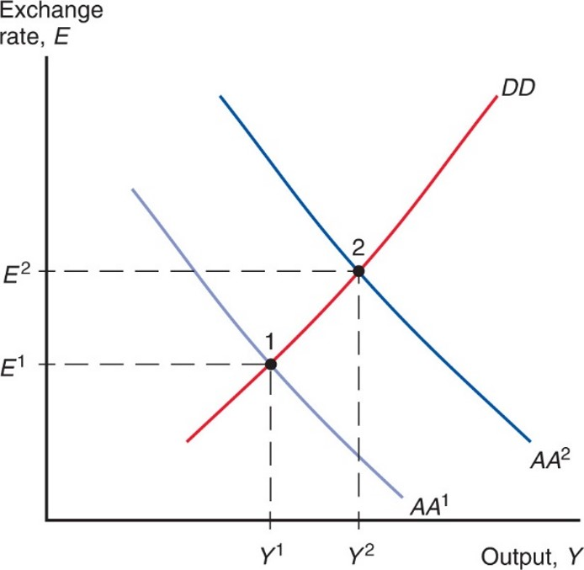
Figure 17.10 Effects of a Temporary Increase in the Money Supply
By shifting
upward, a temporary increase in the money supply
causes a currency depreciation and a rise in output.
Notes:
The falling Ay Ay super 1 curve intersects the rising D D curve at point 1 (Y super 1, E super 1). The Ay Ay super 1 curve shifts upward, forming the graph of Ay Ay super 2, which intersects the D D curve at point 2, which has coordinates (Y super 2, E super 2). Point 2 is up and right of point 1.

Slide 42
Temporary Changes in Fiscal Policy
An increase in government purchases or a decrease in taxes increases aggregate demand and output in the short run.
The D D curve shifts right.
Higher output increases the demand for real monetary assets,
thereby increasing interest rates,
causing the domestic currency to appreciate (E falls).

Slide 43
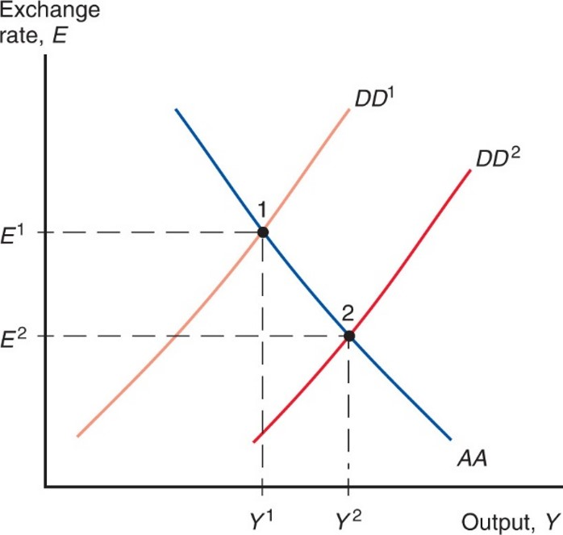
Figure 17.11 Effects of a Temporary Fiscal Expansion
By shifting
to the right, a temporary fiscal expansion causes a
currency appreciation and a rise in output.
Notes:
The falling Ay Ay curve intersects the rising D D super 1 curve at point 1, which has coordinates (Y super 1, E super 1). The D D super 1 curve shifts downward to form the graph of D D super 2. The D D super 2 curve intersects the Ay Ay curve at point 2, which has coordinates (Y super 2, E super 1). Point 2 is down and right of point 1.

Slide 44
Policies to Maintain Full Employment (1 of 3)
Resources used in the production process can either be over-employed or underemployed.
When resources are used effectively and sustainably, economists say that production is at its potential or natural level.
When resources are not used effectively, resources are underemployed: high unemployment, few hours worked, idle equipment, lower than normal production of goods and services.
When resources are not used sustainably, labor is over-employed: low unemployment, many overtime hours, over-utilized equipment, higher than normal production of goods and services.

Slide 45
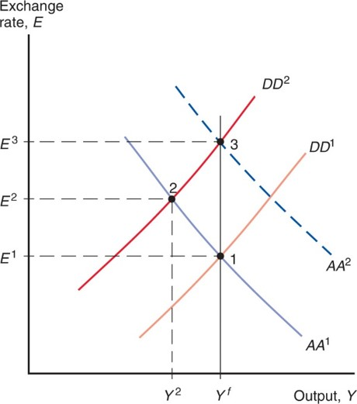
Figure 17.12 Maintaining Full Employment after a Temporary Fall in World Demand for Domestic Products
A temporary fall in world demand shifts
reducing output from
and causing the currency to depreciate from
(point 2). Temporary fiscal
expansion can restore full employment (point 1) by shifting the D D schedule back to its
original position. Temporary monetary expansion can restore full employment (point 3)
by shifting
The two policies differ in their exchange rate effects: The
fiscal policy restores the currency to its previous value
whereas the monetary
policy causes the currency to depreciate further, to
Notes:
The falling Ay Ay super 1 curve intersects the rising D D super 1 curve at point 1, which has coordinates (Y super f, E super 1). The D D super 1 curve shifts upward to form the graph of D D super 2. The D D super 2 curve intersects the Ay Ay super 1 curve at point 2, which has coordinates (Y super 2, E super 2), so that point 2 is up and left of point 1. The Ay Ay super 1 curve then shifts upward to form the graph of Ay Ay super 2. The Ay Ay super 2 curve intersects the D D super 2 curve at point 3. Point 3 is directly above point 1 at (Y super f, E super 3).

Slide 46
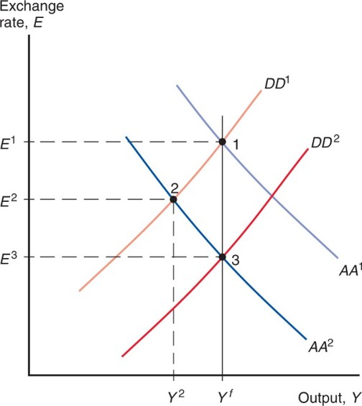
Figure 17.13 Policies to Maintain Full Employment After a Money Demand Increase
After a temporary money demand increase (shown by the shift from
either an increase in the money supply or temporary fiscal expansion can be used to maintain full employment. The two policies have different exchange rate effects: The
monetary policy restores the exchange rate back to
whereas the fiscal policy
leads to greater appreciation
Notes:
The falling Ay Ay super 1 curve intersects the rising D D super 1 curve at point 1, which has coordinates (Y super f, E super 1). The Ay Ay super 1 curve shifts downward to form the graph of Ay Ay super 2. The Ay Ay super 2 curve intersects the D D super 1 curve at point 2, which has coordinates (Y super 2, E super 2), so that point 2 is down and left of point 1. The D D super 1 curve then shifts downward to form the graph of D D super 2. The D D super 2 curve intersects the Ay Ay super 2 curve at point 3. Point 3 is directly below point 1 at (Y super f, E super 3).

Slide 47
Policies to Maintain Full Employment (2 of 3)
Policies to maintain full employment may seem easy in theory, but are hard in practice.
We have assumed that prices and expectations do not change, but people may anticipate the effects of policy changes and modify their behavior.
Workers may require higher wages if they expect overtime and easy employment, and producers may raise prices if they expect high wages and strong demand due to monetary and fiscal policies.
Fiscal and monetary policies may therefore create price changes and inflation, thereby preventing high output and employment: inflationary bias.

Slide 48
Policies to Maintain Full Employment (3 of 3)
Economic data are difficult to measure and to understand.
Policy makers cannot interpret data about asset markets and aggregate demand with certainty, and sometimes they make mistakes.
Changes in policies take time to be implemented and to affect the economy.
Because they are slow, policies may affect the economy after the effects of an economic change have dissipated.
Policies are sometimes influenced by political or bureaucratic interests.

Slide 49
Permanent Changes in Monetary and Fiscal Policy
“Permanent” policy changes are those that are assumed to modify people’s expectations about exchange rates in the long run.

Slide 50
Permanent Changes in Monetary Policy
A permanent increase in the quantity of monetary assets supplied has several effects:
It lowers interest rates in the short run and makes people expect future depreciation of the domestic currency, increasing the expected rate of return on foreign currency deposits.
The domestic currency depreciates (E rises) more than is the case when expectations are constant (Econ Chapter 14/Finance Chapter 3 results).
The A A curve shifts up (right) more than is the case when expectations are held constant.

Slide 51
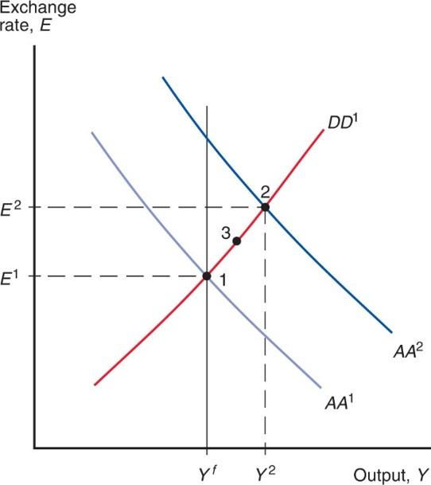
Figure 17.14 Short-Run Effects of a Permanent Increase in the Money Supply
A permanent increase in the money supply, which shifts
and moves the economy from point 1 to point 2, has stronger effects on the exchange rate and output than an equal temporary increase, which moves the economy only to point 3.
Notes:
The falling Ay Ay super 1 curve intersects the rising D D super 1 curve at point 1, which has coordinates (Y super f, E super 1). The Ay Ay super 1 curve shifts upward to form the graph of Ay Ay super 2. The Ay Ay super 2 curve intersects the D D super 1 curve at point 2, which has coordinates (Y super 2, E super 2). Point 3 forms the midpoint of the segment the D D super 1 curve from point 1 to point 2.

Slide 52
Effects of Permanent Changes in Monetary Policy in the Long Run
With employment and hours above their normal levels, there is a tendency for wages to rise over time.
With strong demand for goods and services and with increasing wages, producers have an incentive to raise prices over time.
Both higher wages and higher output prices are reflected in a higher level of average prices.
What are the effects of rising prices?

Slide 53
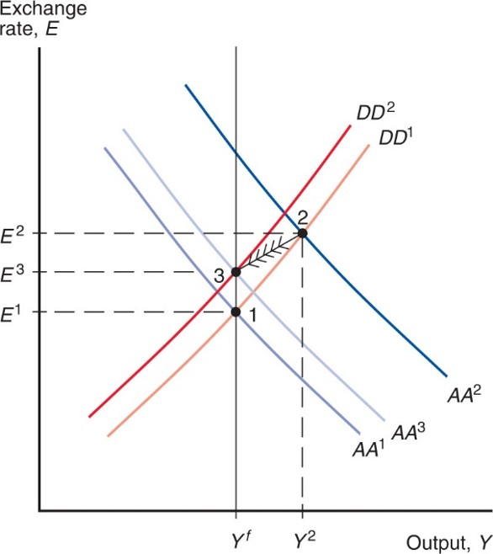
Figure 17.15 Long-Run Adjustment to a Permanent Increase in the Money Supply
After a permanent money supply increase, a steadily increasing price level shifts the D D and A A schedules to the left until a new long-run equilibrium (point 3) is reached.
Notes:
The falling Ay Ay super 1 curve intersects the rising D D super 1 curve at point 1, which has coordinates (Y super f, E super 1). The Ay Ay super 1 curve then shifts upward to form the graph of Ay Ay super 2. The Ay Ay super 2 curve intersects the D D super 1 curve at point 2, which has coordinates (Y super 2, E super 2), so that point 2 is up and right of point 1. The D D super 1 curve then shifts upward to form the graph of D D super 2, and the Ay Ay super 2 curve shifts downward to form the graph of Ay Ay super 3. The graphs for D D super 2 and Ay Ay super 3 intersect at point 3, which has coordinates (Y super f, E super 3). Point 3 is directly above point 1 and down and left of point 2. As a result, movement is from point 2 to point 3.

Slide 54
Effects of Permanent Changes in Fiscal Policy (1 of 2)
A permanent increase in government purchases or reduction in taxes
increases aggregate demand
makes people expect the domestic currency to appreciate in the short run due to increased aggregate demand, thereby reducing the expected rate of return on foreign currency deposits and making the domestic currency appreciate.
The first effect increases aggregate demand of domestic products, the second effect decreases aggregate demand of domestic products (by making them more expensive).

Slide 55
Effects of Permanent Changes in Fiscal Policy (2 of 2)
If the change in fiscal policy is expected to be permanent, the first and second effects exactly offset each other, so that output remains at its potential or natural (or long run) level.
We say that an increase in government purchases completely crowds out net exports, due to the effect of the appreciated domestic currency.

Slide 56
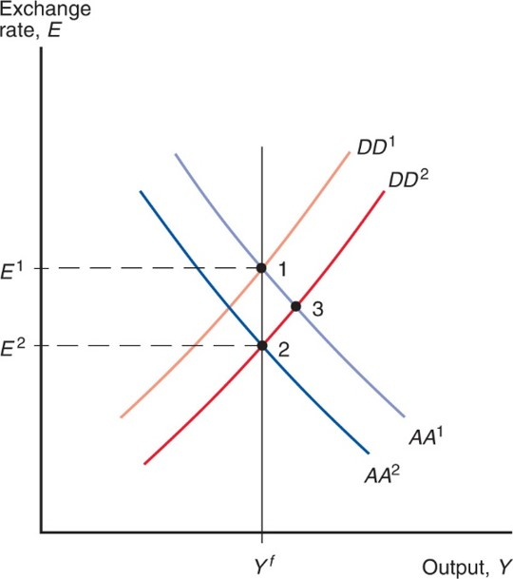
Figure 17.16 Effects of a Permanent Fiscal Expansion
Because a permanent fiscal expansion changes exchange rate expectations,
it shifts
leftward as it shifts
to the right. The effect on output
(point 2) is nil if the economy starts in long-run equilibrium. A comparable temporary fiscal expansion, in contrast, would leave the economy at point 3.
Notes:
The falling Ay Ay super 1 curve intersects the rising D D super 1 curve at point 1, which has coordinates (Y super f, E super 1). The D D super 1 curve then shifts downward to form the graph of D D super 2, and the Ay Ay super 1 curve shifts downward to form the graph of Ay Ay super 2. The D D super 2 curve intersects the Ay Ay super 2 curve at point 2, which has coordinates (Y super f, E super 2). As a result, point 2 is directly below point 1. At the same time, the Ay Ay super 1 curve intersects the D D super 2 curve at point 3, which is down and right of point 1 and up and right of point 2.

Slide 57
Macroeconomic Policies and the Current Account (1 of 4)
To determine the effect of monetary and fiscal policies on the current account,
derive the X X curve to represent the combinations of output and exchange rates at which the current account is at its desired level.
As income from production increases, imports increase and the current account decreases when other factors remain constant.
To keep the current account at its desired level, the domestic currency must depreciate as income from production increases: the X X curve should slope upward.

Slide 58
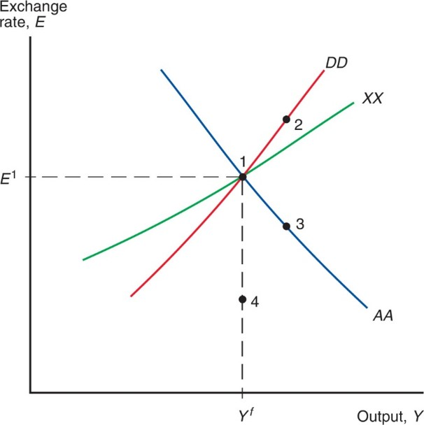
Figure 17.17 How Macroeconomic Policies Affect the Current Account
Along the curve X X, the current account is constant at the level C A = X. Monetary expansion moves the economy to point 2 and thus raises the current account balance. Temporary fiscal expansion moves the economy to point 3, while permanent fiscal expansion moves it to point 4; in either case, the current account balance falls.
Notes:
The falling Ay Ay curve intersects the rising D D and X X curves at point 1, which has coordinates (Y super f, E super 1). The D D curve is steeper than the X X curve, and point 2 is on the D D curve up and right of point 1. Point 3 is on the Ay Ay curve, directly below point 2. Point 4 is directly below point 1.

Slide 59
Macroeconomic Policies and the Current Account (2 of 4)
The X X curve slopes upward but is flatter than the D D curve.
D D represents equilibrium values of aggregate demand and domestic output.
As domestic income and production increase, domestic saving increases, which means that aggregate demand (willingness to spend) by domestic residents does not rise as rapidly as income and production.

Slide 60
Macroeconomic Policies and the Current Account (3 of 4)
As domestic income and production increase, the domestic currency must depreciate to entice foreigners to increase their demand of domestic products in order to keep the current account (only one component of aggregate demand) at its desired level—on the X X curve.
As domestic income and production increase, the domestic currency must depreciate more rapidly to entice foreigners to increase their demand of domestic products in order to keep aggregate demand (by domestic residents and foreigners) equal to production—on the D D curve.

Slide 61
Macroeconomic Policies and the Current Account (4 of 4)
Policies affect the current account through their influence on the value of the domestic currency.
An increase in the quantity of monetary assets supplied depreciates the domestic currency and often increases the current account in the short run.
An increase in government purchases or decrease in taxes appreciates the domestic currency and often decreases the current account in the short run.

Slide 62
Value Effect, Volume Effect, and the J-Curve (1 of 3)
If the volume of imports and exports is fixed in the short run, a depreciation of the domestic currency
will not affect the volume of imports or exports,
but will increase the value/price of imports in domestic currency and decrease the current account:
The value of exports in domestic currency does not change.
The current account could immediately decrease after a currency depreciation, then increase gradually as the volume effect begins to dominate the value effect.

Slide 63
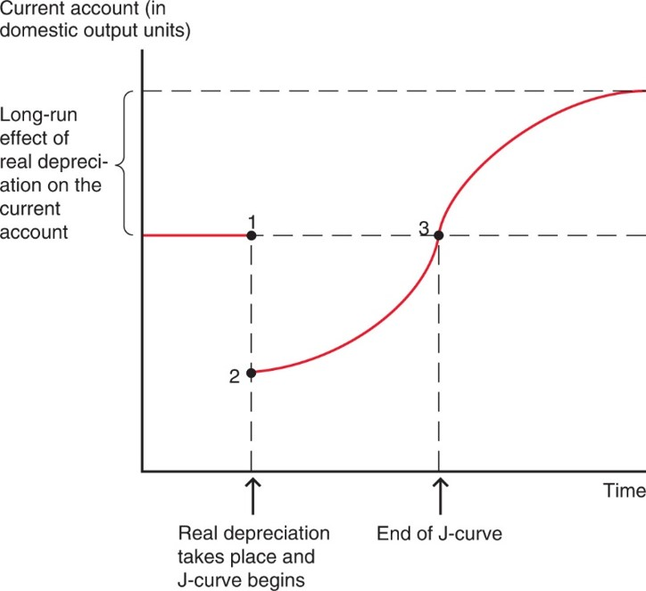
Figure 17.18 The J-Curve
The J-curve describes the time lag with which a real currency depreciation improves the current account.
Notes:
The graph consists of three parts. The first part is a horizontal line segment extending rightward from the y-axis to point 1. The second part is the J curve. The J curve begins at point 2, which is directly below point 1, representing the start of real depreciation. The J curve then rises with increasing steepness to point 3, which is level with point 1. The final part of the graph rises with decreasing steepness from point 3 toward a maximum. The vertical distance from point 3 to the maximum represents the long-run effect of real depreciation on the current account.

Slide 64
Value Effect, Volume Effect, and the J-Curve (2 of 3)
Pass-through from the exchange rate to import prices measures the percentage by which import prices change when the value of the domestic currency changes by 1%.
In the D D-A A model, the pass-through rate is 100%: import prices in domestic currency exactly match a depreciation of the domestic currency.
In reality, pass-through may be less than 100% due to price discrimination in different countries.
Firms that set prices may decide not to match changes in the exchange rate with changes in prices of foreign products denominated in domestic currency.

Slide 65
Value Effect, Volume Effect, and the J-Curve (3 of 3)
If prices of foreign products in domestic currency do not change much because of a pass-through rate less than 100%, then
the value of imports will not rise much after a domestic currency depreciation, and the current account will not fall much, making the J-curve effect smaller.
the volume of imports and exports will not adjust much over time, since domestic currency prices do not change much.
Pass-through of less than 100% dampens the effect of depreciation or appreciation on the current account.

Slide 66
Global Value Chains and Exchange Rate Effects of Export and Import Prices
Some imported intermediate goods become part of goods that are exported, leading to complex global value chains in which multiple countries produce portions of the value added of final products.
For many countries, imported value accounts for a significant portion of the gross value of exports (backward linkages).
A country’s exports may go on to be included in exports from other countries (forward linkages).
Backward and forward linkages tend to dampen the effects of currency depreciations by creating offsetting forces.

Slide 67
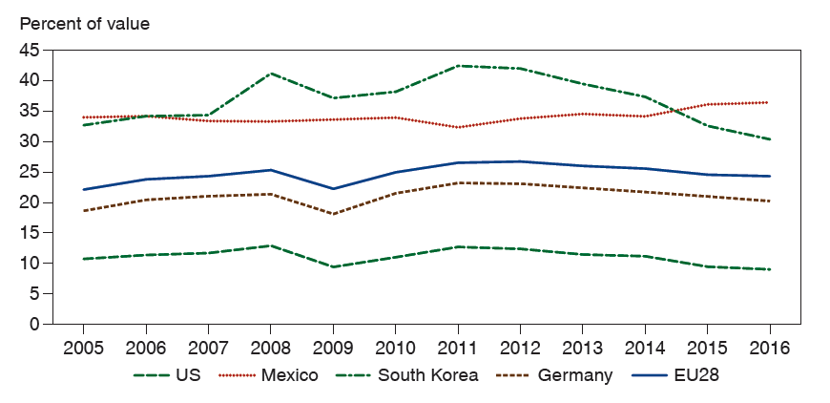
Figure 17.19 Import Content of Exports for Selected Countries in the European Union, 2005–2016
Imported value added can account for a significant fraction of the value of exports.
Source: O E C D.
Notes:
The horizontal axis ranges from 2005 to 20 16 in increments of 1 and vertical axis ranges from 0 to 45 in increments of 5. The import content of exports for the United States is as follows. Year, Percent of value. 2005, 10. 2006, 12. 2007, 13. 2008, 14. 2009, 9. 20 10, 13. 20 11, 14. 20 12, 13. 20 13, 12. 20 14, 11. 20 15, 10.5. 20 16, 10. The import content of exports for Mexico is as follows. Year, Percent of value. 2005, 34. 2006, 34. 2007, 33. 2008, 33. 2009, 33. 20 10, 34. 20 11, 32. 20 12, 35. 20 13, 36. 20 14, 35. 20 15, 36. 20 16, 37. The import content of exports for South Korea is as follows. Year, Percent of value. 2005, 33. 2006, 35. 2007, 35. 2008, 43. 2009, 37. 20 10, 38. 20 11, 44. 20 12, 43. 20 13, 40. 20 14, 38. 20 15, 34. 20 16, 33. The import content of exports for Germany are as follows. Year, Percent of value. 2005, 18. 2006, 20. 2007, 21. 2008, 21. 2009, 17. 20 10, 20. 20 11, 23. 20 12, 23. 20 13, 22. 20 14, 21. 20 15, 21. 20 16, 20. The import content of exports for European Union 28 is as follows. Year, Percent of value. 2005, 23. 2006, 24. 2007, 24.5. 2008, 25. 2009, 22. 20 10, 25. 20 11, 26.5. 20 12, 25.5. 20 13, 25. 20 14, 24.5. 20 15, 24. 20 16, 24. All values are estimated.

Slide 68
The Liquidity Trap (1 of 3)
During the Great Depression of the 1930s, the nominal interest rate hit zero in the United States, and the country found itself in a liquidity trap.
Once an economy’s nominal interest rate falls to zero, a central bank experiences difficulty lowering it any further.
At negative nominal interest rates, people find holding money preferable to bonds.
Central banks may want to avoid the zero lower bound (Z L B) on the nominal interest rate to keep monetary expansion as an option.
Starting in 2014, some major central banks have pushed nominal interest rates into slightly negative territory.

Slide 69
The Liquidity Trap (2 of 3)
The dilemma facing a central bank when the economy is in a liquidity trap slowdown can be seen by considering the interest parity condition when the domestic interest rate R = 0,
Assume for the moment that the expected future exchange rate,
is fixed.
Suppose the central bank raises the domestic money supply so as to depreciate the currency temporarily
that is, to raise E today but return the exchange rate to
the level
later.

Slide 70
The Liquidity Trap (3 of 3)
The interest parity condition shows that E cannot rise once R = 0 because the interest rate would have to become negative.
Instead, despite the increase in the money supply, currency cannot depreciate further and the exchange rate remains steady at
At an interest rate of R = 0, people are indifferent between bonds and money as both yield a zero nominal rate of return.
An increase in the money supply has no effect on the economy!

Slide 71
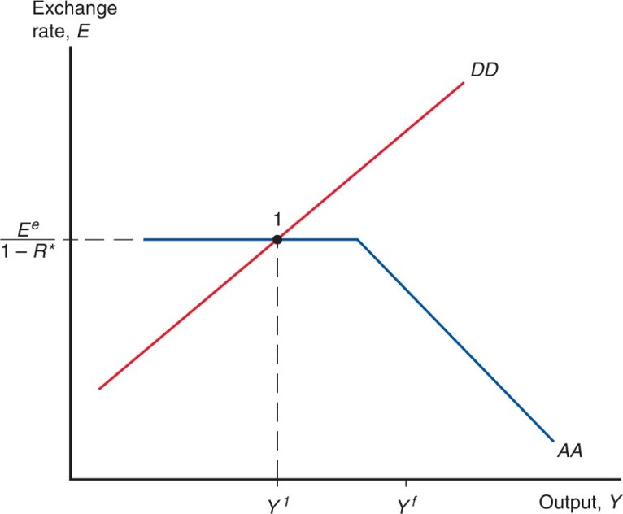
Figure 17.20 A Low-Output Liquidity Trap
At point 1, output is below its full employment level. Because exchange rate
expectations
are fixed, however, a monetary expansion will merely shift
A A to the right, leaving the initial equilibrium point the same. The horizontal stretch of A A gives rise to the liquidity trap.
Notes:
The graph of Ay Ay extends rightward through point 1 at (Y super 1, upper E super lower e, over, 1 minus R star. The graph of Ay Ay then falls diagonally through a point at x = Y super f. The D D curve rises through the graph of Ay Ay at point 1.

Slide 72
Summary (1 of 3)
Aggregate demand is influenced by disposable income and the real exchange rate.
The D D curve shows combinations of exchange rates and output where aggregate demand = aggregate output.
The A A curve shows combinations of exchange rates and output where the foreign exchange markets and money market are in equilibrium.

Slide 73
Summary (2 of 3)
In the D D-A A model, we assume that a depreciation of the domestic currency leads to an increase in the current account and aggregate demand.
But reality is more complicated, and the J-curve shows that the value effect at first dominates the volume effect.

Slide 74
Summary (3 of 3)
A temporary increase in the money supply is predicted to increase output and depreciate the domestic currency.
A permanent increase does both to a larger degree in the short run, but in the long run output returns to its normal level.
A temporary increase in government purchases is predicted to increase output and appreciate the domestic currency.
A permanent increase in government purchases is predicted to completely crowd out net exports, and therefore to have no effect on output.

Slide 75
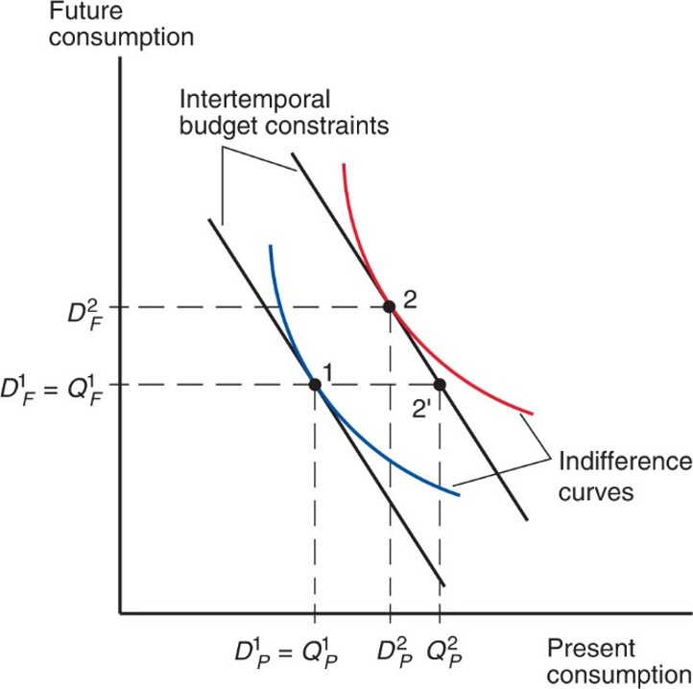
Figure 17A1.1 Change in Output and Saving
Notes:
The first indifference curve falls with decreasing steepness through point 1, which has coordinates (D sub P super 1 = Q sub P super 1, D sub F super 1 = Q sub F super 1). The corresponding intertemporal constraint is the falling line tangent to the indifference curve at point 1. The second indifference curve falls with decreasing steepness through point 2, which has coordinates (D sub P super 2, D sub F super 2), so that point 2 is up and right of point 1. The corresponding intertemporal budget constraint is the falling line tangent to the indifference curve at point 2. This line also falls through point 2 prime, which has coordinates (Q sub P super 2, D sub F super 1 = Q sub F super 1). Point 2 prime is level with point 1.

Slide 76
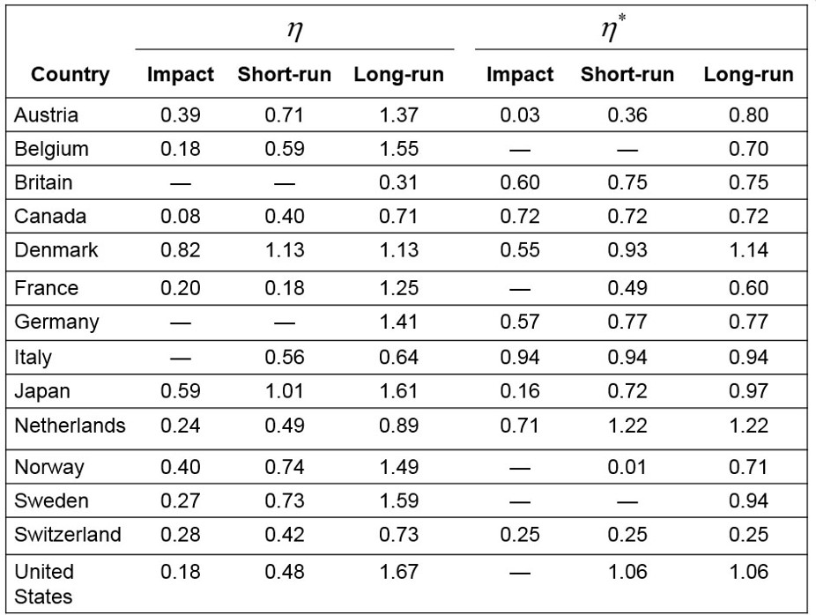
Table 17A2.1 Estimated Price Elasticities for International Trade in Manufactured Goods
Source: Estimates come from Jacques R. Artus and Malcolm D. Knight, Issues in the Assessment of the Exchange Rates of Industrial Countries. Occasional Paper 29. Washington, D.C.: International Monetary Fund, July 1984, table 4. Dashes indicate unavailable estimates.
Notes:
For each country, the table provides the impact, short-run, and long-run eta values, followed by the impact, short-run, and long-run eta star values, as follows. Austria. Eta: 0.39, 0.71, 1.37. Eta star: 0.03, 0.36, 0.80. Belgium. Eta: 0.18, 0.59, 1.55. Eta star: none, none, 0.70. Britain. Eta: none, none, 0.31. Eta star: 0.60, 0.75, 0.75. Canada. Eta: 0.08, 0.40, 0.71. Eta star: 0.72, 0.72, 0.72. Denmark. Eta: 0.82, 1.13, 1.13. Eta star: 0.55, 0.93, 1.14. France. Eta: 0.20, 0.18, 1.25. Eta star: none, 0.49, 0.60. Germany. Eta: none, none, 1.41. Eta star: 0.57, 0.77, 0.77. Italy. Eta: none, 0.56, 0.64. Eta star: 0.94, 0.94, 0.94. Japan. Eta: 0.59, 1.01, 1.61. Eta star: 0.16, 0.72, 0.97. Netherlands. Eta: 0.24, 0.49, 0.89. Eta star: 0.71, 1.22, 1.22. Norway. Eta: 0.40, 0.74, 1.49. Eta star: none, 0.01, 0.71. Sweden. Eta: 0.27, 0.73, 1.59. Eta star: none, none, 0.94. Switzerland. Eta: 0.28, 0.42, 0.73. Eta star: 0.25, 0.25, 0.25. United States. Eta: 0.18, 0.48, 1.67. Eta star: none, 1.06, 1.06.

Slide 77

Copyright
This work is protected by United States copyright laws and is provided solely for the use of instructors in teaching their courses and assessing student learning. Dissemination or sale of any part of this work (including on the World Wide Web) will destroy the integrity of the work and is not permitted. The work and materials from it should never be made available to students except by instructors using the accompanying text in their classes. All recipients of this work are expected to abide by these restrictions and to honor the intended pedagogical purposes and the needs of other instructors who rely on these materials.

